Slide 1
Linux Filesystem Hierarchy
Operating Systems
CEIS106 July 2022
Christopher Hill
Professor Thomas

Slide 2
Navigate the Linux filesystem tree
1. What is the pwd command an acronym for? What about the cd command?
The pwd command stands for Print Working Directory, which outputs the full pathname so the user can know where they’re working in the file system. The cd command stands for Change Directoy, which allows the user to “hop” into another level or location within the file system.
2. Explain the differences between a relative path and an absolute/full path in Linux.
An absolute path always starts and is printed from the root directory. A relative path is referenced from the current working directory downwards. If I’m in my user directory and want to access a file one folder deeper, I would only need to type scripts/test_script.sh, for example.
References:
1. https://linuxize.com/
2. https://linuxhandbook.com/absolute-vs-relative-path/

Slide 3
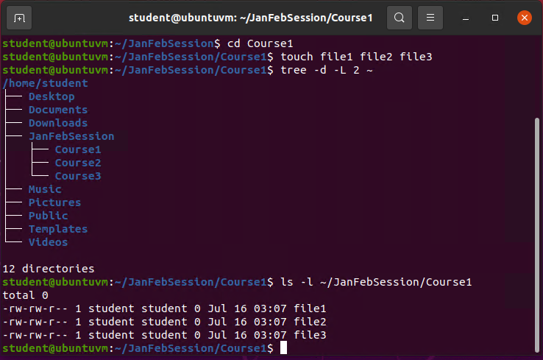
Create directories and files

Slide 4
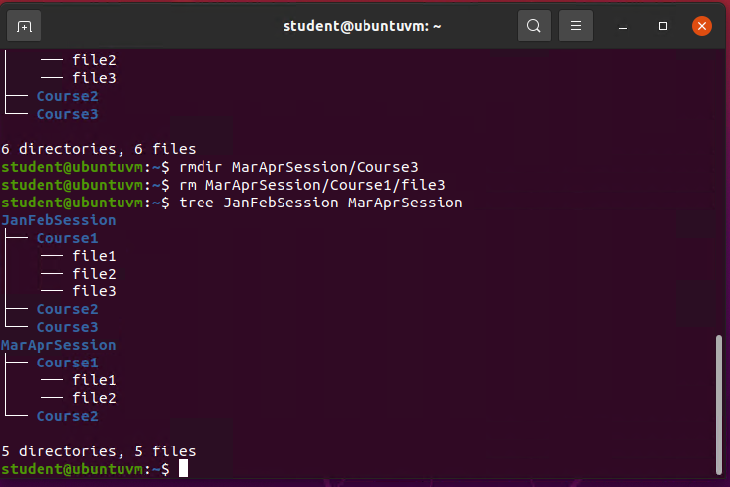
Copy and remove directories and files

Slide 5
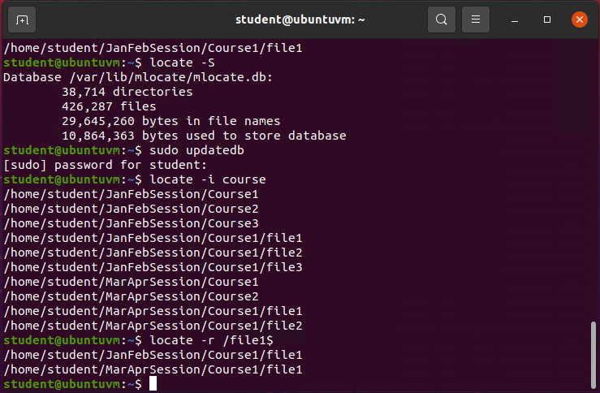
Locate directories and files

Slide 6
Create a shell script
1. What are the file permissions of the script?
Read/write for the owner and group with no execution. Read only for everyone else.
2. What’s the name of the user-defined variable in the script?
text
3. Which redirection meta-character is used in the script? What does it do?
Redirects and appends the output to the file. A single arrow overwrites the file.
References:
1. https://www.cyberciti.biz/faq/linux-append-text-to-end-of-file/

Slide 7
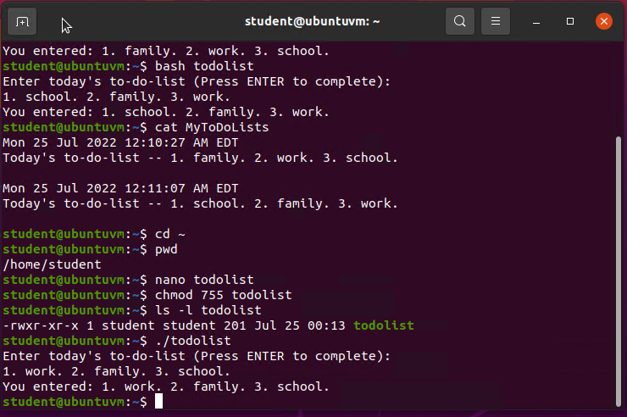
Change script file permissions

Slide 8
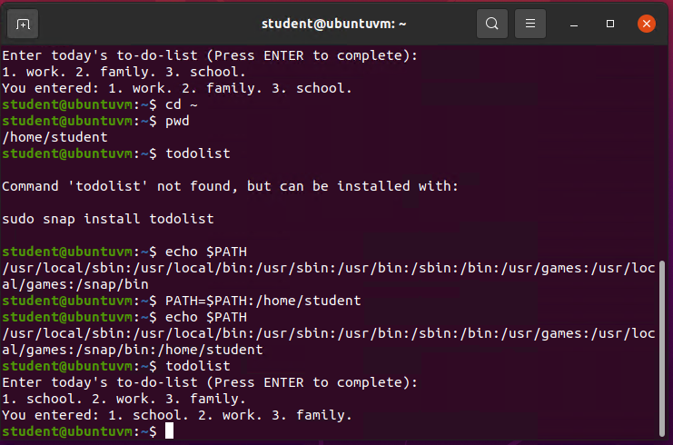
Set the PATH variable

Slide 9
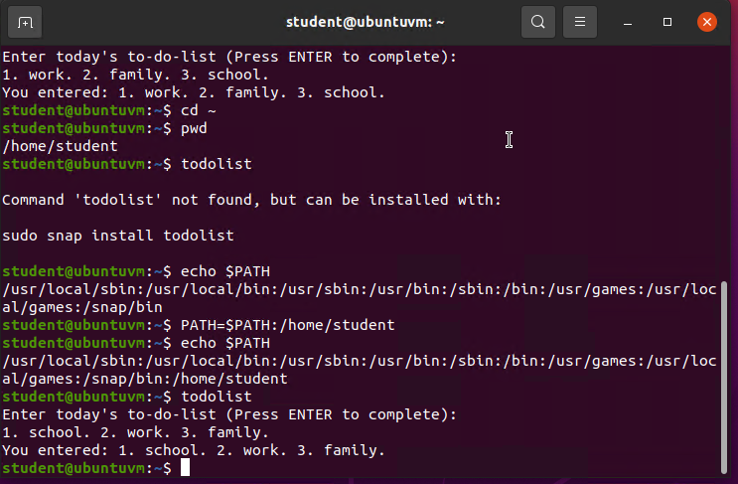
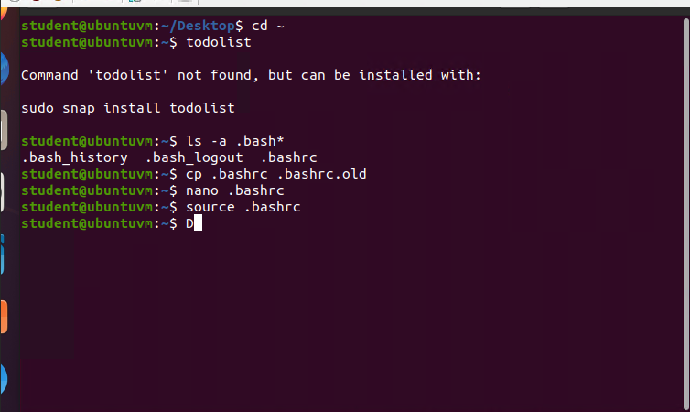
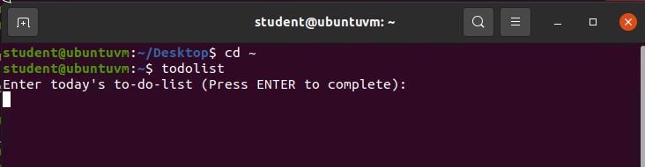
Make the PATH variable permanent

Slide 10

Add users and groups in CLI
1. What does the –m option in the useradd command do?
It creates the home directory for the new user
2. What does the -3 option in the tail command do?
Only shows the last three lines
3. Which line of the /etc/group file lists members of the “students” group?

Slide 11
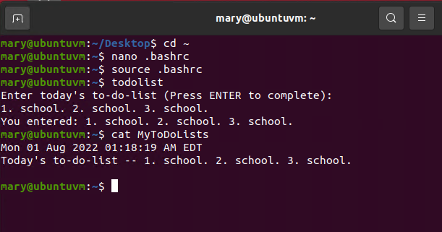
Test user and group settings

Slide 12
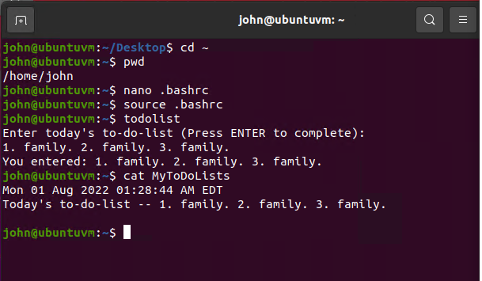
Add users in GUI

Slide 13
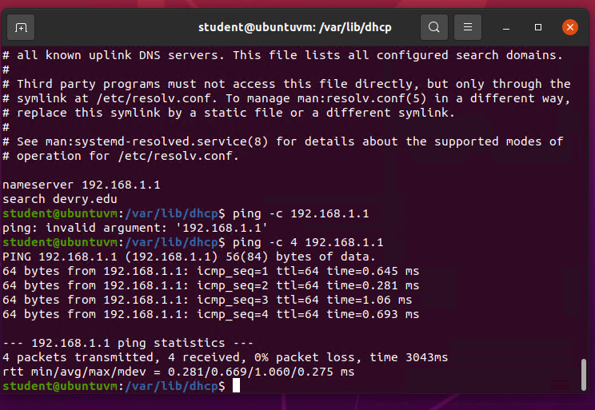
Discover host IP configurations
1. What is the IP address of your Ubuntu machine?
192.168.1.104
2. What is the IP address of its default gateway?
192.168.1.1
3. What is the IP address of its DHCP server?
192.168.1.1
4. What is the IP address of its DNS server?
192.168.1.1

Slide 14
Manage network interfaces
1. Which DHCP message is shown in the output of the sudo dhclient –v –r eth0 command?
DHCPRELEASE
2. Which four DHCP messages are shown in the output of the sudo dhclient –v eth0 command?
DHCPDISCOVER, DHCPOFFER, DHCPREQUEST, DHCPACK

Slide 15
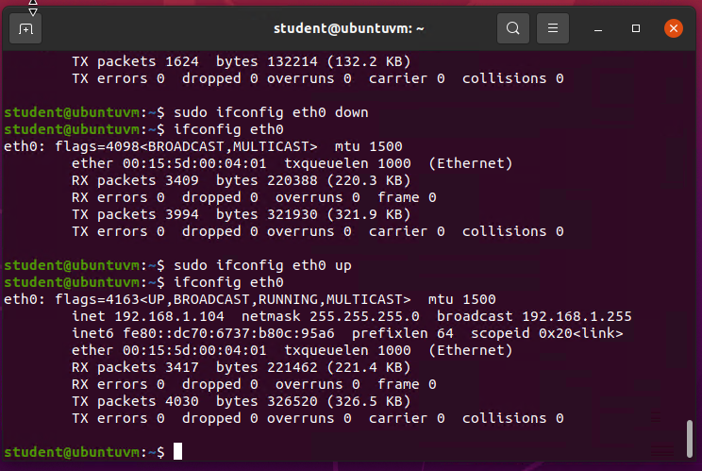
Use network utilities

Slide 16
Monitor Linux processes
1. What is the default action of the 15 SIGTERM kill signal?
Kills the highlighted process in the terminal
2. In the System Monitor window, click on % CPU to sort the processes by CPU load. Which process shows the highest percentage of CPU usage?
gnome-terminal-server

Slide 17
Monitor user activities
Issue the sudo accton on command to turn on GNC accounting. Run the sudo updatedb command. Enter lastcomm updatedb to check if the updatedb command was executed before.
1. What flag value is displayed in the output?
S (superuser)
2. Why is the name of the user who ran the processes shown as root, not student?
sudo (“superuser do”) was placed before the command

Slide 18
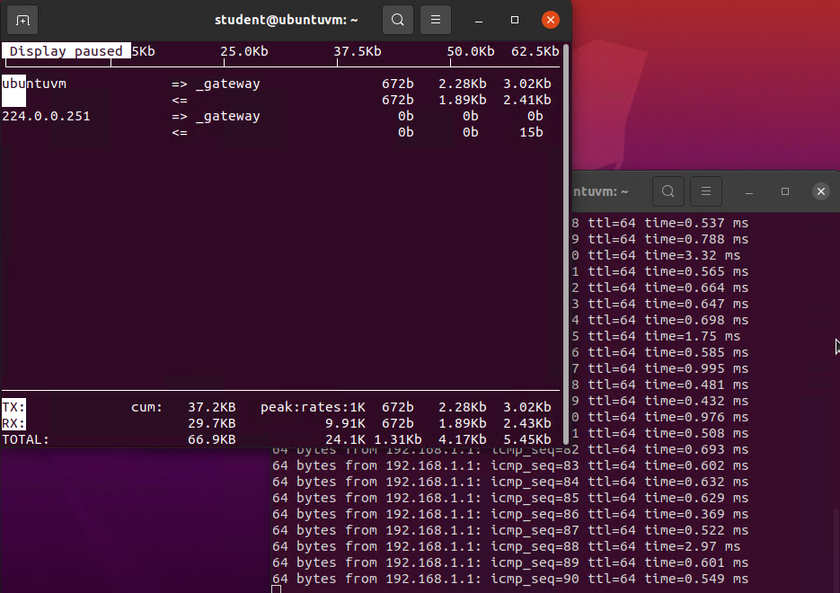
Monitor network bandwidth usage

Slide 19
Challenges
Linux is case sensitive per function
Somewhat difficult syntax to memorize

Slide 20
Conclusion
Linux was challenging at first but became much easier with practice
ITProTV was an invaluable tool and resource for becoming familiar with the Linux system and functions

